Slide 1


MINISTRY OF EDUCATION
TECHNOLOGICAL UNIVERSITY (TAUNGGYI)
DEPARTMENT OF ELECTRONIC ENGINEERING
Design and Implementation of Voice Recognition Based Wireless Home Automation System Using Zigbee
First Seminar

Slide 2
Outlines of Presentation
Introduction
Aim and objectives
Overall Block diagram
Implementation of procedure (or) programs
Literature Review
Hardware and software requirements
Conclusion
Next plan (or) Future plan
Time schedule
References

Slide 3
Introduction
The purpose of this research is to facilitate elderly and disabled people with an easy to use home automation system.
This research allows to control house hold appliances from a centralized control unit which is wireless and control lights ,fans ,air conditioners ,television sets, electronic doors etc.…..
The base station unit takes decisions and sends the commands to remote station by Zigbee transceiver and performs further operation.

Slide 4
Aim and Objectives
Aim
To design and Implementation of Voice Recognition Based Wireless Home Automation Using Zigbee.
Objectives
To provide the security to the home and control the electrical appliances in the home from the remote place using Zigbee technology.
To design a home controlling system using voice commands.
To provides a user friendly interface especially for vision impaired user.

Slide 5
Overall Block Diagram
Zigbee
Transceiver
Module
LED
Gas Sensor
Arduino Uno
Fan
4
-
channel relay
module
HC05
Bluetooth
Buzzer
Module
Door

Slide 6
Implementation Procedure (or) Programs
Step 1:Setting up transmitter and receiver hardware.
Step 2:Learning program to implement .
Step 3:Implementing program.
Step 4:Result output.

Slide 7
Literature Review
Ref No | Type | Title | Controller | Components | Function
1 | Project Report 2016 | Wireless Home Automation system using IOT | Microcontroller | WIFI Module , Opto-coupler, Triac , resistors , capacitors , diodes, regulator, Loads(home appliances) | To control all the devices of smart home through internet protocols
2 | Project Report 2017 | Voice controlled home automation | Arduino | Arduino Board , Relay Module , Bluetooth module ,Breadboard, Android Phone, Fan , LED | To build a perfect companion for someone who is elderly and physical-disabled

Slide 8
Over Cloud
WIFI Module
3.3V VOLTAGE
5V DC SIIMPS
ON
INTERNET
WEB
REGULATOR
OPTOCOUPLER
TRIAC
LOAD
AC SUPPLY
Fig. Block Diagram Of Wireless Home Automation system using IOT

Slide 9
LCD
LED
4
-
channel Relay Module
Bluetooth module
Arduino Uno
FAN
Mobile
phone
External 5V
Fig . Block Diagram Of Voice Control Home Automation Using Arduino

Slide 10
Hardware and software Requirements
Hardware
Power supply
Bluetooth Module (HC05)
Arduino UNO
Gas sensor (MQ2)
Buzzer
4-channel relay
Zigbee Module
Fan
LED
LCD
Servo motor
Software
Arduino IDE software

Slide 11
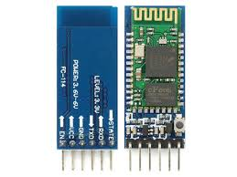
HC05 Bluetooth Module
HC05 module is an easy to use Bluetooth SPP (Serial Port Protocol) module , designed for transparent wireless serial connection setup.
HC-05 Bluetooth Module can be used in a Master or Slave configuration, making it a great solution for wireless communication.

Slide 12
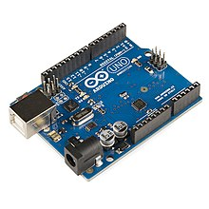
Arduino UNO
Arduino Uno is an open-source microcontroller board based on the Microchip ATMEGA328P microcontroller and developed by Arduino.cc.
The board is equipped with sets of digital and analog input/output (I/O) pins that may be interfaced to various expansion boards (shields) and other circuits.
The board has 14 digital I/O pins (six capable of PWM output), 6 analog I/O pins, and is programmable with the Arduino IDE (Integrated Development Environment), via a type B USB cable.

Slide 13
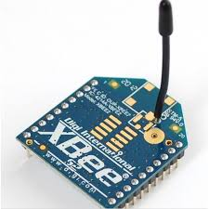
Zigbee Module
ZigBee is a specification for high level communication protocols using small, low-power digital radios for personal area networks.
ZigBee is designed for devices which require simple wireless networking and don't need high data transfer rate
It can be used as sensor network, information displays, home- and industrial automatic systems, etc.

Slide 14
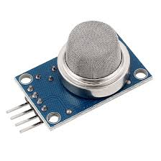
MQ2 Gas Sensor
MQ2 gas sensor is an electronic sensor used for sensing the concentration of gases in the air such as LPG, propane, methane, hydrogen, alcohol, smoke and carbon monoxide.
It contains a sensing material whose resistance changes when it comes in contact with the gas.

Slide 15
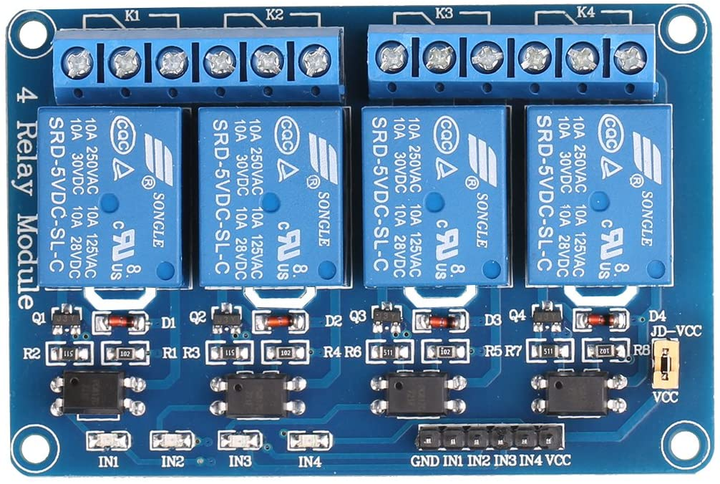
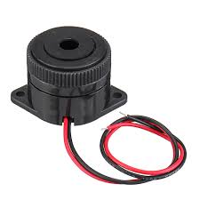
Buzzer
4-Channel Relay
Buzzer or beeper is an audio signaling device, which may be mechanical, electromechanical, or piezoelectric (piezo for short).
Buzzer include alarm devices, timers, and confirmation of user input such as a mouse click or keystroke.
The 4 Channel Relay Module is a convenient board which can be used to control high voltage, high current load such as motor, solenoid valves, lamps and AC load.
It is designed to interface with microcontroller such as Arduino, PIC and etc.

Slide 16
FAN

Slide 17
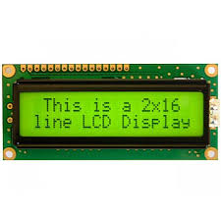
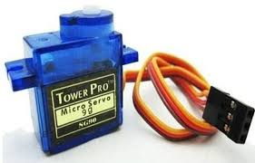
Liquid Crystal Display
Servo motor
An LCD (Liquid Crystal Display) screen is an electronic display module and has a wide range of applications.
A 16x2 LCD means it can display 16 characters per line and there are 2 such lines
A servo motor is an electrical device which can push or rotate an object with great precision.
Servo motor can rotate and object at some specific angles or distance.
It is made up of simple motor which run through servo mechanism

Slide 18
Conclusion
Nowadays , home automation research become a very useful project for the adults and physically disabled persons, who are not able to do various activities efficiently when they are at home and need one’s assistant to perform those tasks.
This research eliminate the complication of wiring in case of wired automation.
Home automation using zigbee considers amount of power saving and compatible with future technologies.
Zigbee network provides secure access to home.

Slide 19
Next Plan (or) Future Plan
In second seminar
Setting up transmitter hardware and testing sensor .
Writing program in Arduino IDE software
Result some output .

Slide 20
Title Seminar | Introduction about this thesis | 17th February 2020
First Seminar | Literature review , operation and components | June 2020
Second Seminar | Testing and Operation the thesis | July 2020
Third Seminar | Pre-explanation of the overall system | September 2020
Final Defense | Explanation of the overall system | October 2020

Slide 21
References
Control home security system website.[cited 2010 14th October].Available:
http://www.itechnews.net/2008/05/20/control-home-security-system/[4].R.Gadalla/
The Z-Wave technology available at http://www.z-wavealliance,org/technolgy
Zigbee Home Automation available at http://www.zigbee.org/Standards/
Home Security systems, home security products , and home alarm systems available at http://www.adt.com

